Slide 1
Group Member & Respective Roles
Team Leader: Yiu Hong Sum
Requirement Analysis: Bryan Lim
SDLC: Chen ZhenNi
Implementation: Lim Yan Jun
Design: Deon Tan

Slide 2





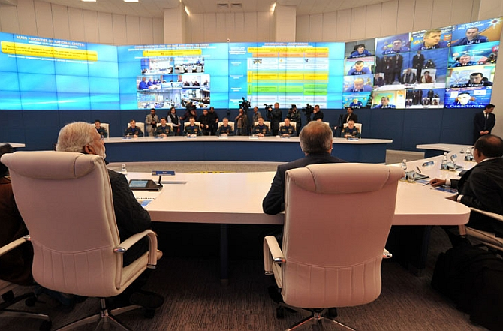

Artist Illustration
911 Supervisor in Classification Team
CMO Liaison Officer
911 Operator
911 API
CMO API
Caller
EF
CMO

Slide 3
High-level design
specification
911subsystem ::= <swproduct>⁺ + <Secured Network> + <Operator>⁺ + <Access Pass Legacy,Manual>⁺ + <Power Line>⁺ + <Firewall >⁺ + <Workstation OS >⁺ + <Supervisor>⁺ + <Google Map API> + <MySQL> + <ASP.NET Framework> + <911-CMO API> + <911-EF API> + [ <CMO liaison officer>⁺]
swproduct ::= <Compiledcode>⁺ + [ <doc>⁺]

Slide 4
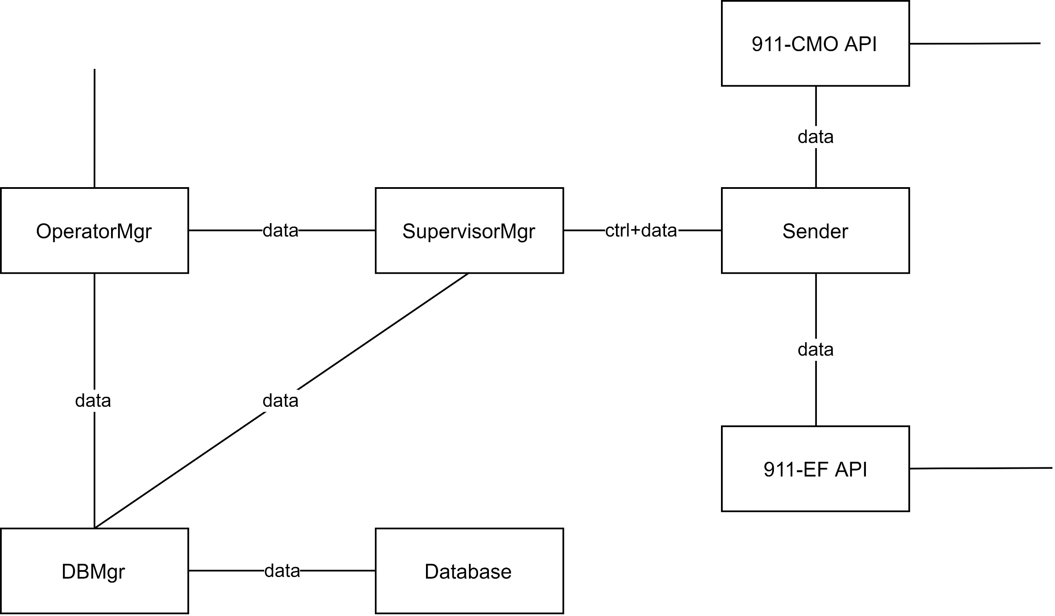
Initiate structure & behaviour architecture

